Slide 1
APS to SQLDW Migration
Process and Tools
Prepared by Microsoft
August, 2018

Slide 2
Agenda
Goals and Benefits of process
Workshop
Migration Process
Migration Tools

Slide 3
Migration Approach

Slide 4
APS Migration – Goals and Benefits
Goals:
Smooth and effective deployment to achieve customer success
Set up implementation work for success
Drive Partner business opportunities
Drive deployment of SQLDW
Drive quality references
Achieved through:
Quality knowledge transfer to customers
Customer specific discovery and design
Based on the customer’s business requirements
Deliver an implementable plan

Slide 5
APS Migration
Discovery workshop
Complete a migration assessment questionnaire.
Perform a Pre-Assessment of the APS System. (tools available from MS)
Determine Database to Schema migration approach.
Determine the scope of the migration.
Implementation
Configure Export/Import Process (APS & SQLDW)
Script out the APS objects (Schemas/Tables/Views/SPs).
Get Data Validation – Row Counts on Tables in APS
Create SQLDW Schemas/Tables/Views
Create/Migrate SQLDW SPs
Create External Tables (APS and SQLDW)
Setup Scheduled Jobs (ETL) (Carried out by Customer)
Export Data to Azure
Import Data into SQLDW
Rebuild Indexes/Stats
Migrate Security (Carried out by Customer with Microsoft’s Assistance)
Validate Data between APS and SQLDW– Row Counts
Performance tune SQLDW

Slide 6
Discovery workshop - Objectives
Provide customer with overview of how to migrate existing DW solutions to Azure
Review the high-level vision of the customer, business, and project scope
Gather detailed metadata on the existing APS system to accurately estimate the migration
Understand data use cases
Understand end-to-end solution architecture
Understand availability requirements of data
Understand load / query performance expectations
Identify 3rd party solution integration tools in use
Understand code artifacts requiring migration re-work in the existing solution
Understand data flow timing and the available windows for migration
Understand the existing infrastructure of the complete solution

Slide 7
APS Migration Steps – Discovery workshop
The discovery workshop duration depends on the complexity of the customers implementation.
Complete a migration assessment questionnaire. – Prior to workshop
Perform a Pre-Assessment of the APS System. (tools available from MS) - Prior to workshop
Determine Database to Schema migration approach.
Determine the scope of the migration.

Slide 8
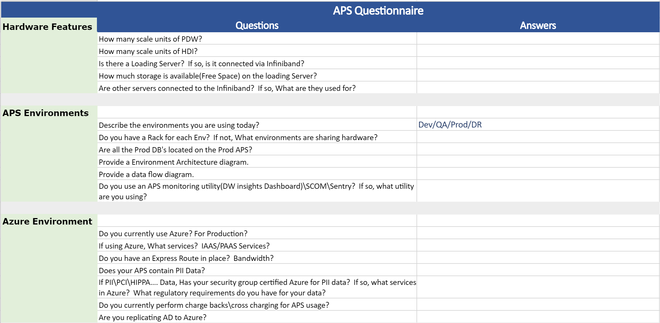
APS Migration Steps – Questionnaire
Document is prepared by both you and the customer to help determine the correct Azure infrastructure needed to support their existing and future plans.

Slide 9
APS Migration Steps – Pre-Assessment
Assessment script to gather information on the APS system to better enable an accurate estimate for the migration. This script captures the following info:
Version of the APS system – @@version - Version_{Datetime}.csv
Count of all objects in all DB’s in the APS. – sys.objects - ObjectCount_{Datetime}.csv
List of all tables and their attributes (distribution type, # partitions, storage type and Distribution column) – various system tables – TableMetadata_{DateTime}.csv
Listing of the ShowSpaceUsed for all tables. – DBCC pdw_showspaceused – ShowSpaceUsed_{Datetime}.csv
Report the number of nodes and total number of distributions on the APS.
List of Tables with table name, schema name, and database name in a CSV file that can be used to script out the "Create Table" Statements.
List of Views with view name, schema name, and database name in a CSV file that can be used to script out the "Create View" Statements.
List of Stored Procedures with stored procedure name, schema name, and database name in a CSV file that can be used to script out the "Create Proc" Statements.
Notes:
Uses Invoke-sqlcmd
Dbcc pdw_showspaceused – errors on external tables but continues to run. Using is_external to filter the tables can cause errors on older versions of APS.
Notes:
Line 104 of RunSQLStatementExportCSV.ps1 has is_External as a column. This might not be valid for all versions of APS. If excluded and a table is an external table, then an error is thrown but program continues to run. If is_external is removed then the if statement on lines159-160 need to be replaced.

Slide 10


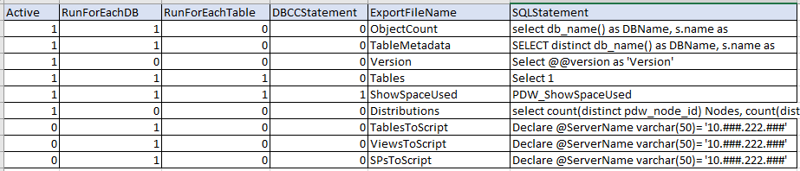
Migration Tools Steps – 0) Pre-Assessment
APS (PDW)
CVS Script Config File
PreAssessmentDriver.ps1
Prompts for several items
RunSQLStatementExportCSV.ps1
Uses Invoke-SQLCMD to execute the sql statement
Output.csv
1 = Run the line
0 = Skip the line

Slide 11
Migration Tools Steps – 0) Pre-Assessment Config
1. Create configuration CSV File config files the PreAssessment.ps1 program. This is a CSV file containing the following columns:
Parameter | Purpose | Value (Sample)
Active | 1 – Run line, 0 – Skip line | 0 or 1
RunForEachDB | 1 – yes, 0 = no If set to 1, this will loop through each DB on the APS and run the SQL Statement. Currently This does not support running for a single DB. | 0 or 1
RunForEachTable | 1 – yes, 0 = no If set to 1, this will loop through each Table int eh DB and run the SQL Statement. Currently This does not support running for a single Table. | 0 or 1
DBCCStatement | 1 – yes, 0 = no Identifies if the statement is a dbcc command. Currently this only supports pdw_Showspaceused. | 0 or 1
ExportFilename | Name of the output file to save the sql statement results. Datetime will be added to the end of the filename along with .csv. | ObjectCount
FileName | Name of the File to store the script in. This should match the object name if possible | DimAccount
SQLStatement | SQL Statement to run | Any SQL statement is valid at the table or DB level. However, inside the T-SQL Statements where APS server name is specified: Declare @ServerName varchar(50)= ‘10.###.222.###’, the masked IP address needs to be replaced with the actual APS IP Address or APS server name.

Slide 12
Migration Tools Steps – 0) Pre-Assessment
Run the PowerShell script(PreAssessmentDriver.ps1). This script will prompt for the following information
“Enter the name of the SQLScriptToRun.csv File.” – This will be the location\name of the config File SQLScriptToRun.csv.
Default: C:\APS2SQLDW\0_PreAssessment\SQLScriptToRun.csv
“Enter the Path of the Output File Directory.” – This will be the location all result/output files are sent to
Default: C:\APSPreAssessment\Output\0_PreAssessment
“Enter the name of the Server”
This is the APS server you are wanting to connect to: “aps,17001” or “APS Server IP Address, 17001”
“Enter ‘Yes’ to connect using Integrated security, otherwise Enter 'No'”
Allows YES or No
If No to last question, “Enter the User Name if not using Integrated:” – User name with permission run the scripts
“PDW Password” – Enter the Password for the user – reads password as a secure string
Notes:
Scripts are located in our team site at 1)

Slide 13

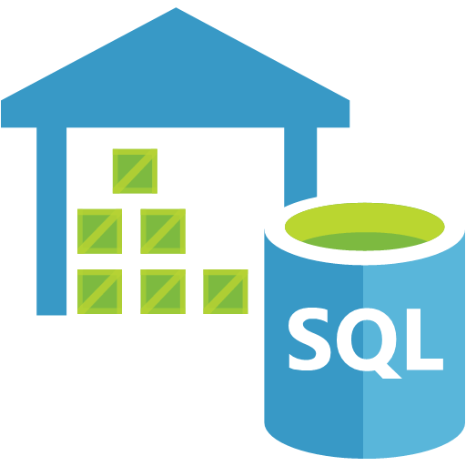
Migration Process – Schemas vs DB
APS is an instance level service that supports multiple databases. Azure SQL DW is a database-level service that has one database per instance.
In order for the Azure SQL DW to host all the original APS databases and the tables, the original APS schema in various databases need to be changed to an appropriate (different) name.
A sample schema mapping matrix is illustrated in this table on the right.
APS_DB_1
Schemas:
APS_DB_2
Azure
SQL DW
APS
Appliance
APS_DB3
APS DB | APS Schema | SQLDW Schema
AdventureWorks | DBO | AdventureWorks or AW_dbo
AdventureWorks | Sales | AW_Sales
CS_STAGE | CSS | CSS_ST
CS_STAGE | DBO | DBO_ST
CS_WAREHOUSE | CSS | CSS_DW
CS_DATAMART | CSS | CSS_DM

Slide 14
APS Migration Steps – Scoping
The results of the Pre-Assessment can be used to assist in scoping the APS migration to SQLDW.
The output can be pulled into an Excel PowerPivot model and sliced on the necessary info to give counts and table sizes.
Prerequisite: Install-Module ImportExcel (Run the command from a PS command prompt. Command Prompt must be running as admin)
Pulls the newest files based on date from the Assessment into Excel.

Slide 15
Migration Tools Steps – Scoping
Run the PowerShell script(CopyDataToExcel.ps1). This script will prompt for the following information
“Enter the Path to the Pre-Assessment output files.” – This will be the location\name of the pre-Assessment output.
Default: C:\APS2SQLDW\output\0_PreAssessment
“Enter the Path to save excel file.”
Default: C:\APS2SQLDW\output\0_PreAssessment
“Enter the name of the Excel File”
Pre-Assessment.xlsx
Notes:
Scripts are located in our team site at 1)

Slide 16

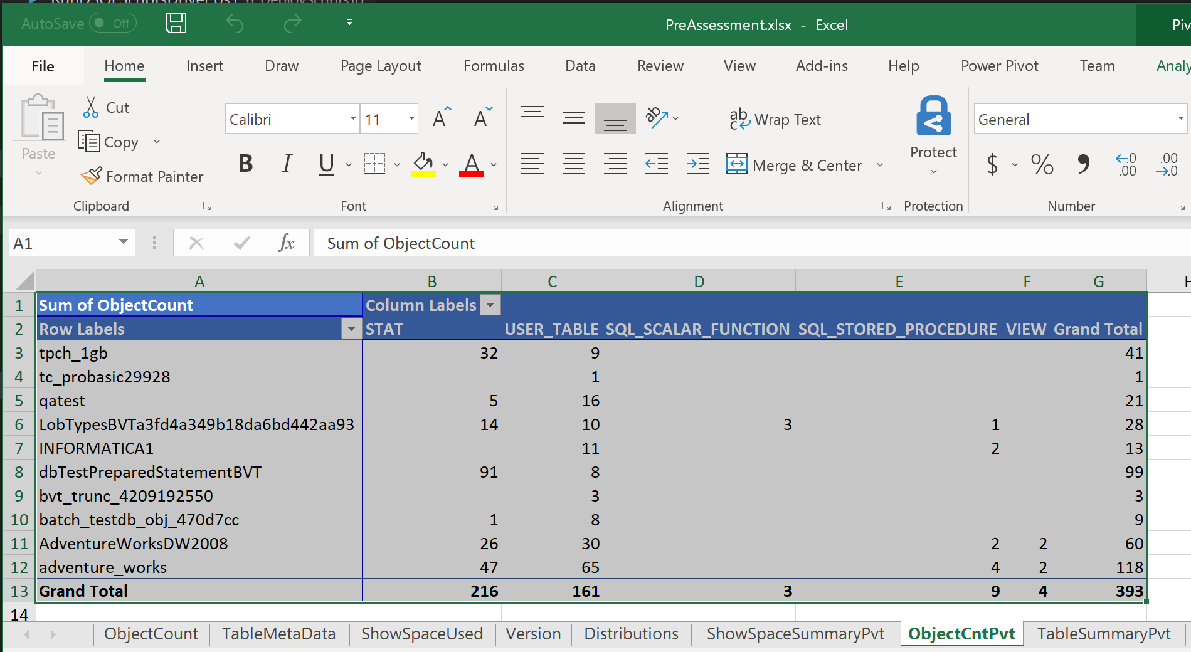
Migration Tools Steps – Scoping
Pre-Assessment Output
CopyDataToExcel.ps1
Prompts for several items
Pre-Assessment.xlsx
Output:
Single Excel sheet with 8 tabs.
ObjectCount – Data from Pre-Assessment
TableMetaData – Data from Pre-Assessment
ShowSpaceUsed – Data from Pre-Assessment
Version – Data from Pre-Assessment
Distributions – Data from Pre-Assessment
ObjectCntPvt – Pivot table with Object Count data
ShowSpaceUsedPvt – Pivot Table with ShowSpaceUsed Data
TableSummaryPvt – Pivot Table with Table Meta Data

Slide 17
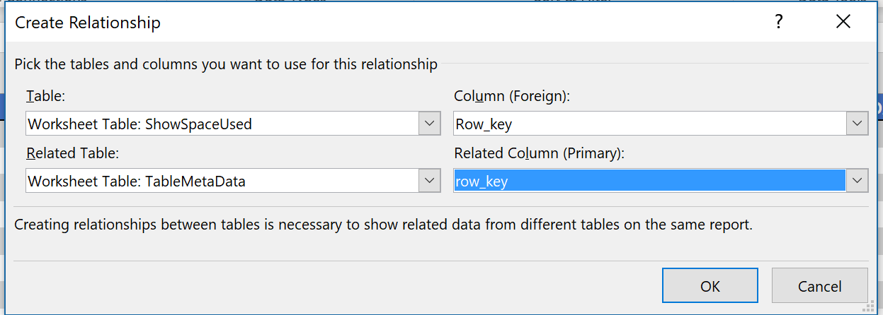
Migration Tools Steps – Scoping
Note: ShowspaceUsed and TableMetaData can be joined together on RowKey. In Excel, go to the data tab and select relationships and click add.
Notes:
Scripts are located in our team site at 1)

Slide 18
APS vs
Azure DW

Slide 19
Architecture for APS - Distributions
CREATE TABLE myTable (column Defs) WITH ( DISTRIBUTION = HASH (id));
HP
7 - Racks
2 - 56 Compute nodes
8-node (1 data rack) appliance
MPP Node 1
Create Table <table GUID>_a
Create Table <table GUID>_b
…
Create Table <table GUID>_h
8 tables per node
Dell & Quanta
6 - Racks
2 - 54 Compute nodes
9-node (1 data rack) appliance
MPP Node 2
Create Table <table GUID>_a
Create Table <table GUID>_b
…
Create Table <table GUID>_h
MPP Node …
MPP Node 8
Create Table <table GUID>_a
Create Table <table GUID>_b
…
Create Table <table GUID>_h
Final result – 8 Compute Nodes
64 individual tables across an
8-node (1 data rack) appliance
Notes:
Creating a distributed table:
- MPP DWH Engine translates statement to T-SQL to run for each Distribution

Slide 20
Architecture for Azure SQLDW - Distributions
CREATE TABLE myTable (column Defs) WITH ( DISTRIBUTION = HASH (id));
Azure Storage Blob(s)
D1
D2
D3
D4
D5
D6
D7
D8
D9
D10
D11
D12
D13
D14
D15
D16
D17
D18
D19
D20
D21
D22
D23
D24
D25
D26
D27
D28
D29
D30
D31
D32
D33
D34
D35
D36
D37
D38
D39
D40
D41
D42
D43
D44
D45
D46
D47
D48
D49
D50
D51
D52
D53
D54
D55
D56
D57
D58
D59
D60
Notes:
Creating a distributed table:
- MPP DWH Engine translates statement to T-SQL to run for each Distribution

Slide 21
Architecture for Azure DW – DW100
Azure SQL Data Warehouse
Azure Storage Blob(s)
D1
D2
D3
D4
D5
D6
D7
D8
D9
D10
D11
D12
D13
D14
D15
D16
D17
D18
D19
D20
D21
D22
D23
D24
D25
D26
D27
D28
D29
D30
Engine
Worker1
D31
D32
D33
D34
D35
D36
D37
D38
D39
D40
D41
D42
D43
D44
D45
D46
D47
D48
D49
D50
D51
D52
D53
D54
D55
D56
D57
D58
D59
D60

Slide 22
Architecture for Azure DW – DW600
Azure SQL Data Warehouse
Azure Storage Blob(s)
Worker1
D1
D2
D3
D4
D5
D6
D7
D8
D9
D10
Worker2
D11
D12
D13
D14
D15
D16
D17
D18
D19
D20
Engine
Worker3
D21
D22
D23
D24
D25
D26
D27
D28
D29
D30
Worker4
D31
D32
D33
D34
D35
D36
D37
D38
D39
D40
Worker5
D41
D42
D43
D44
D45
D46
D47
D48
D49
D50
Worker6
D51
D52
D53
D54
D55
D56
D57
D58
D59
D60

Slide 23
APS Migration – APS & DW Major Differences
APS:
Compute nodes range from 2 – 56
Distributions vary from 16 – 448
SQL Capabilities depend on version installed
GetDate() – Returns date based on APS time zone
Multiple Databases
Default Index – HEAP
DWLoader
Azure DW:
Compute nodes range from 1 – 60
Distributions are Static at 60
SQL Capabilities - What’s currently available on Azure SQL DW
Getdate() – Returns only UTC Time. Can’t be changed
Single Database
Default Index – Clustered Column Store (CCI)
No DWLoader - SQL DW Upload Task in SSIS (SSIS Azure Feature pack)

Slide 24
Migration
Process

Slide 25

Migration Process – APS
The following items need to be migrated from APS to SQLDW.
DDL (Table)
Code (Stored Procedures, Views and ETL process)
Security
Data
The DDL and DML can be migrated using internal tools available from MS (APS Migration Tools and DWScripter)
Security will need to be migrated by hand.
To migrate the Data to Azure, several approaches can be taken. Each approach has a set of prerequisites as well as pros and cons. Each method should be weighed against the customers environment, data load frequency and security requirements.
Data Migration Approach:
BCP data out of APS – Polybase data into SQLDW from WASB or Azure Data Lake
Polybase data out of APS to ASB (Azure Storage Blob) - Polybase data into SQLDW from ASB or Azure Data Lake.
SSIS – Source(APS) Destination(SQLDW)
ADF – Extract data from APS to SQLDW
Import Export Service

Slide 26
https://www.microsoft.com/en-us/download/confirmation.aspx?id=53591
Migration Tasks
1
Script Objects
3
Convert Object to SQLDW
DDL
DDL
Create Table
Create External Table
Create Table
Create External Table
DML
DML
5
Deploy Objects
Create View
Create Stored Procedure
Create View
Create Stored Procedure
Security
Security
Not Written
Create User/DB User
Secure Objects/Data
Create User/DB User
Secure Objects/Data
2
Create Data Migration Objects
Import Scripts
Data
6
APS
Create Ext Tables
CTAS/Insert
Import Data
4
Export Data
CSV
RC

Slide 27


Data Migration Approach – BCP Out Polybase In
BCP Data out of APS – Polybase data into SQLDW
While APS did not receive BCP in support until AU4, this method will still work on earlier versions as the process is exporting data and not importing. This process utilizes the SQL Server tool BCP to export data out of the APS system and store the data in Flat Files. These files are then copied to either WASB or Azure DataLake where they can be consumed using Polybase to load SQLDW.
Pros:
Can break up large table by partition.
Can Zip files before moving them to Azure in another step.
Familiar tool for SQL Server DBA’s.
Data reloads for Dev/QA/Prod does not need to extract unchanged data from APS
Cons:
All data is passed through the control node and therefore is single threaded. To utilize multiple export paths, multiple BCP commands will be necessary.
Must have local disk space to store files until they are moved to Azure.
Potential file delimiter issues
BCP
Local Disk
Optional
ZIP
Copy Process
Local Disk
AZCopy
Power
Shell
Polybase
Polybase

Slide 28
Data Migration Approach – Polybase Out Polybase In
Polybase Data out of APS – Polybase data into SQLDW
Polybase is one of the fasted methods for importing and exporting data from APS to SQLDW. However, the true speed is dependent on the connection speed between APS and Azure. The overall speed needs to be tested. Before using this method, clearance should be obtained from the organizations IT/Security group to insure the export will not consume the bandwidth of the Azure connection. Polybase does have the ability to compress files as they are created. APS can only create the Polybase file on WASB. IF they are to be stored/consumed from ADLS, an additional step will be needed to copy them to ADLS from WASB.
Pros:
Can break up large table by partition. Will require additional External Tables.
Can Zip files before moving them to Azure.
Each Distribution runs in parallel making this the fastest method to export/import file into SQLDW. Export speed is dependent on the network connection to Azure.
Data reloads for Dev/QA/Prod do not need to extract unchanged data from APS again
Cons:
APS can only utilize WASB currently.
Potential file delimiter issues
Polybase
ADLCopy /
Powershell
Polybase
Polybase

Slide 29

Data Migration Approach – SSIS
SSIS – ELT of data from APS to SQLDW
SSIS can be used to automate the data extract from APS and import into SQLDW.
There are two (2) Options with this approach:
Extraction of the data to flat files in one task. Utilize Polybase to import the Files to SQLDW
Extraction of the data and direct insert into the SQLDW Tables.
Flat File to Azure – Polybase into SQLDW Approach:
Pros:
Can Zip files before moving them to Azure.
Large Tables can be extracted by partition eliminating the need to load all the data in a single migration operation.
Can move the File to WASB or ADLS
Logging built into SSIS
Can use Scripting to create SSIS Packages (BIML, Ezapi, SSIS API)
Data reloads for Dev/QA/Prod do not need to extract unchanged data from APS
Cons:
Additional overhead of using SSIS (Licenses and Server)
Possible delimiter issues
SSIS
OR
Polybase
Polybase

Slide 30
Data Migration Approach – SSIS
SSIS – ELT of data from APS to SQLDW
Direct Insert to SQLDW:
Pros:
Large Tables can be extracted by partition eliminating the need to load all the data in a single migration operation.
Logging built into SSIS
Can use Scripting to create SSIS Packages (BIML, Ezapi, SSIS API)
No need for additional space for flat Files
No issues with delimiters
Cons:
Data reloads during testing must extract data from source.
Additional overhead of using SSIS (Licenses and Server)
Data is not compressed before sending to SQLDW
SSIS

Slide 31


Data Migration Approach – ADF
ADF – Data extract from APS to SQLDW
ADF can be used to automate the data extract from APS and import into SQLDW.
There are two (2) Options with this approach:
Extraction of the data to flat files in one task. Utilize a second task to import the Files to SQLDW
Extraction of the data and direct insert into the SQLDW Tables.
Flat File Extract to Blob/ADLS Approach:
Pros:
Large Tables can be extracted by partition eliminating the need to load all the data in a single migration operation.
Can move the File to WASB or ADLS
Logging built into ADF
Can use Scripting to create ADF process
Data reloads for Dev/QA/Prod does not need to extract unchanged data from APS
Cons:
Possible delimiter issues
Speed is limited to the speed of the control node. Data is copied to Blob or ADLS first. Does not use Polybase on the APS to extract data.
Additional setup and configuration of Azure Data Management Gateway
Files are copied to WASB or ADLS before being sent to SQLDW
OR
Polybase
Polybase

Slide 32
Data Migration Approach – ADF
ADF – Data extract from APS to SQLDW
Direct Insert to SQLDW:
Pros:
Large Tables can be extracted by partition eliminating the need to load all the data in a single migration operation.
Logging built into ADF
Can use Scripting to create ADF Tasks
Cons:
Data reloads during testing must extract data from source.
Speed is dependent on the how fast the control node can provide data. This does not use polybase to extract data on APS.
Additional setup and configuration of Azure Data Management Gateway
Potential Delimiter issues
Files are copied to WASB or ADLS before being sent to SQLDW

Slide 33
Data Migration Approach – Azure Import/Export Service
Azure Export/Import Service
The Azure export/import service can be used to transfer large datasets from on premises to Azure through the use of a SATA Hard Drive. The files need to be copied to an external hard drive that has been registered/configured in the Azure Portal to be used with this service. The drive is then shipped to Azure where the data is copied to the specified WASB account during configuration.
Pros:
Can Zip files before moving them to azure.
Large Tables can be extracted by partition eliminating the need to load all the data in a single migration operation.
Data reloads for Dev/QA/Prod do not need to extract unchanged data from APS.
Bitlocker encrypted drive.
Cons:
Additional time to get data to Azure. Shipping and loading process.
Possible delimiter issues.
Changes/Deltas between the initial extract and the final load has the potential to be larger than the previous methods.
Can only load to WASB.
Additional configuration\install\removal\shipping of Sata Drive.
BCP
Local Disk
Optional
ZIP
Ship Drive
Local Disk
Script/ADLCopy
Polybase
Polybase

Slide 34
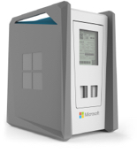
Data Migration Approach – Azure Data Box Service
Azure Data Box (Disk) Service
The Data Box service can be used to transfer very large datasets (Up to 100TB) from on premises to Azure. If the data size is less than 40TB, Data Box Disk service may be used. You can order the Data Box or Disk through Azure portal which will be shipped to customer location by Microsoft. Customer can then connect the Data Box into their network (or USB/SATA connection in case of Data Disk) and copy the files to it. The Box or Disks then shipped to Azure data center where the data is imported into customer specified WASB account.
Pros:
Can Zip files before moving them to azure.
Very large datasets (40 to 100TB) can be moved easily.
Microsoft provides the necessary storage hardware.
AES encryption of the data for strong security.
Cons:
Additional time needed to get data to Azure due to shipping and loading process.
Changes/Deltas between the initial extract and the final load has the potential to be larger than the previous methods.
Relatively less repeatability.
Additional configuration\install\removal\shipping of storage.
BCP
Optional
ZIP
Ship Drive
Script/ADLCopy
Polybase
Polybase

Slide 35
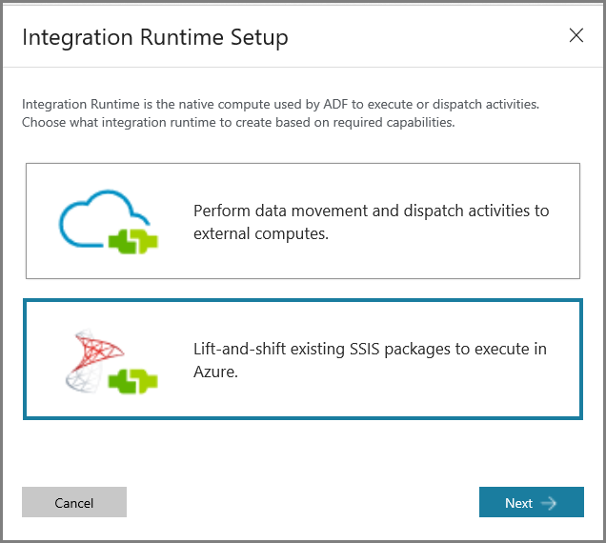
SSIS Migration Approach – Lift and Shift with ADF V2
SSIS Migration
If customer is using SSIS packages for ongoing ingestion of data, same packages can be migrated to Azure for ingesting data directly into SQL DW.
Here are the steps:
Provision SSIS on Azure
Create SSIS Catalog (SSISDB)
Create Azure-SSIS Integration Runtime
Modify Packages
Use latest version of SSDT (15.3 or later)
Modify connection strings with SQL DW as target
Deploy Packages to SSIS on Azure
Connect to SSISDB in Azure
Use project deployment model
Run/Schedule Packages
Use Execute SSIS Package activity in ADF V2
Schedule using
ADF Pipeline
SSMS
SQL DB Elastic Job
SQL Server Agent on-premises

Slide 36
Data Migration Approach – Oracle
Oracle to SQLDW
There are two(2) methods we would suggest for Oracle data migration to SQLDW.
Export data to Flat Files – Polybase to SQLDW
SSIS to SQLDW.
ADF – Requires gateway
Our suggested approach would be to utilize option 1:
Pros:
Can Zip files before moving them to azure.
Large Tables can be extracted by partition eliminating the need to load all the data in a single migration operation.
Data reloads for Dev/QA/Prod do not need to extract unchanged data from APS.
Files can be placed on ADSL through a Powershell script.
Delta changes between initial extract and final load can be managed.
Cons:
Possible delimiter issues.
Tracking of deltas between initial load and final extract.
Export
Local Disk
Optional
ZIP
Copy Process
Local Disk
Polybase

Slide 37
APS Polybase Setup (pre – APS 2016)
The following preparation steps need to be performed on the APS system. Please work with the Customer’s APS support engineer to configure the APS with these steps. This will require a restart of the APS region.
Modify core-site.xml file on PDW control node to add Azure BLOB storage credentials
This file is available under C:\Program Files\Microsoft SQL Server Parallel Data Warehouse\100\Hadoop\conf\
Modify ‘Hadoop Connectivity’ PDW configuration option to enable BLOB connectivity
Ex: EXEC sp_configure 'hadoop connectivity', 4;
RECONFIGURE;
3. Restart PDW region

Slide 38
APS Polybase Setup (pre – APS 2016) – Contd.
After BLOB storage access is configured, the following steps need to be completed for Polybase access to the Blob storage:
Configure DNS forwarders with external DNS names on AD01 and AD02 (if not already done)
Create External Data Source (Linked to the Azure Blob Storage Account and a particular container)
CREATE EXTERNAL DATA SOURCE myBlobDS with (
TYPE = HADOOP,
LOCATION = 'wasbs://myblobcontainer@myblobstorageaccount.blob.core.windows.net’,
3. Create External File Format
CREATE EXTERNAL FILE FORMAT RCFileFormat WITH (
FORMAT_TYPE = RCFILE,
SERDE_METHOD = 'org.apache.hadoop.hive.serde2.columnar.LazyBinaryColumnarSerDe' )

Slide 39
APS Polybase Setup (APS 2016+)
The following preparation steps need to be performed on the APS (2016 or higher) system for Polybase access to the Blob storage.
Modify ‘Hadoop Connectivity’ PDW configuration option to enable BLOB connectivity
Create a Master Key on the database (if not already done)
Create Database Scoped Credential (linked to Azure Blob Storage Account)
Create External Data Source (Linked to the Azure Blob Storage Account and a particular container)
Create External File Format

Slide 40
APS Polybase Setup (APS 2016+) – Contd.
Here is an example:
EXEC sp_configure 'hadoop connectivity', 4;
RECONFIGURE;
CREATE MASTER KEY ENCRYPTION BY PASSWORD = 'P@ssword!23’;
CREATE DATABASE SCOPED CREDENTIAL myBlobCred
WITH IDENTITY = ‘myblobstorageaccount', -- Blob Storage Account Name
SECRET = 'ThisisMaskedKeyLongNameLongStringGenerated GetThisKeyFromYourAzureStorageAccount==‘ -- Blob Storage Access Key
CREATE EXTERNAL DATA SOURCE myBlobDS with (
TYPE = HADOOP,
LOCATION = 'wasbs://myblobcontainer@myblobstorageaccount.blob.core.windows.net’,
CREDENTIAL = myBlobCred -- This name must match the database scoped credential name
CREATE EXTERNAL FILE FORMAT RCFileFormat WITH (
FORMAT_TYPE = RCFILE,
SERDE_METHOD = 'org.apache.hadoop.hive.serde2.columnar.LazyBinaryColumnarSerDe' )

Slide 41
APS Polybase Setup
Polybase needs to be setup and configured on the APS system. Please utilized the Customers DSE to configure the APS for Polybase. Prior to APS 2016, this will require a reboot of the system.
After Polybase is configured the following steps need to be completed for Polybase to access the Blob storage.
Setup Polybase Connectivity to Azure Blob Storage
EXEC sp_configure 'hadoop connectivity', 4;
RECONFIGURE;
Create Database Scoped Credential (linked to Azure Blob Storage Account)
CREATE DATABASE SCOPED CREDENTIAL myblobCred
WITH IDENTITY = ‘myaccountname', -- Blob Storage Account Name
SECRET = 'ThisisMaskedKeyLongNameLongStringGenerated GetThisKeyFromYourAzureStorageAccount==‘ -- Blob Storage Access Key
Create External Data Source (Linked to the Azure Blob Storage Account and a particular container)
CREATE EXTERNAL DATA SOURCE AzureBlobDS with (
TYPE = HADOOP,
LOCATION = 'wasbs://mycontainer@myaccountname.blob.core.windows.net’,
CREDENTIAL = myblobCred -- This name must match the one created in step (2))

Slide 42
Data Migration – Export and Import Data
Exporting data from APS to import into SQLDW can be problematic due to delimiter issues and Datetime problems globally.
If using Delimited Text File Format, Newline and/or Carriage Return appears inside of varchar or char field, causing Polybase to treat it as end of the entire record.
Workaround: export to RC/ORC/Parquet.
If using RCFile, ORCFile, Parquet, Empty Text Values in original database appears as ‘empty’ in text file, causing importing process to translate it as null, which will not be accepted if the SQLDW table defines the field as ‘not null’.
Workaround 1: Clean up records in original DB where data is not valid or missing and should not be exported in the first place.
Workaround 2: Temporarily change the empty strings in APS into a recognizable values that later can be replaced in SQLDW with empty string.
Workaround 3: Temporarily change the SQLDW column definition to allow Null. After Import, create new table with original APS table definition and copy data over to the new table from imported table.
Exporting to RC, ORC file format will cause the datetime on import to be converted to UTC.
Workaround: Convert the data field definition from datetime to varchar when export APS data. Then convert back to datetime when import data into SQLDW.

Slide 43
Data Migration – Export/Import Issues
Data export from APS and/or import into SQLDW may fail due to certain Polybase limitations, as explained below:
Using Delimited Text File Format – Line Feeds (LF) and/or Carriage Returns (CR) embedded inside a string field.
Polybase treats these characters as first-class citizens and breaks the strings during the export.
Workaround 1: export using RCFile/ORC/Parquet File Format
Workaround 2: Replace embedded CR/LFs with any other supported characters during the export
2. Using RCFile/ORC/Parquet File Format, blank Values in string column will be implicitly converted to NULL during export.
Export will fail if the string column is defined as NOT NULL. Possible data corruption if customer wants to treat NULLs and blanks distinctly
Recommendation: Use Delimited Text File Format.
Workaround 1: Clean up data in source DB to remove/replace any unnecessary blank values
Workaround 2: Temporarily change the empty strings in source DB to supported values, replace them back to empty strings once import is complete
Workaround 3: Temporarily change the SQLDW column definition to allow Null. After Import, create new table with original APS table definition and CTAS data over to the new table from imported table.
Workaround 4 (Not recommended): Set Reject_Value in external table definition to a higher value so that errored rows can be ignored during the export. Even if export does not throw errors, not all records will be imported.

Slide 44
Data Migration – Export/Import Issues (Contd.)
Exporting datetime data using RCFile, ORC, or ORC format
Datetime values will be converted to UTC during the import.
Workaround 1: Convert the datetime values to varchar during the export. Convert values back to datetime during the import to SQLDW. Ex: SELECT CONVERT(NVARCHAR(25), PostTime, 121) AS PostTime FROM [EXTDatabaseLog]
Workaround 2: Use Delimited Text file format for export/import.
Exporting with USE_TYPE_DEFAULT set to TRUE in External File Format Definition.
This may cause unintended data value changes, as it will convert all blank values in string columns to NULLs,
numeric/float columns to ‘0’ and in DATETIME columns to ‘1900-01-01’
Recommendation: Set the USE_TYPE_DEFAULT to FALSE and take any appropriate action on the blank values before the export

Slide 45
Data Migration – Export/Import Issues (Contd.)
5. Exporting data to Premium BLOB storage or ADLS
External table creation with the location pointing to Premium BLOB storage or ADLS will fail as it is currently not supported
Workaround 1: Use Standard BLOB storage account as the location
Workaround 2: Use BCP to export the data to local storage first and use manual methods to upload files to BLOB storage/ADLS
Exporting data from very large tables
Export may fail intermittently due to network bandwidth or Java related issues
Workaround 1: Use BCP to export the data to local storage first and use manual methods to upload files to BLOB storage/ADLS
Workaround 2: Export the data from large tables in batches (Ex: by partition, by filter condition etc.)

Slide 46
Data Migration – Export and Import Data
* Summary of Issues and Workaround for Using Delimited Text, RF File, ORC File, and Parquet File
Export/Import | Scenarios | DELIMITEDTEXT-NoZip | RCFile-NoZip | ORCFile-NoZip | ParquetFile-NoZip
APS-Export | 1 - Column Delimiter | OK | OK | OK | OK
APS-Export | 2 - String Delimiter | OK | OK | OK | OK
APS-Export | 3 - Line Feed | OK | OK | OK | OK
APS-Export | 4 - Empty And Null Strings | OK | Empty strings in "Not Null" columns cause errors. Data cleansing necessary. | Same as RC File | Same as RC File
APS-Export | 5 -Dates And Time | OK | Cannot Export Dates with Mixed Formats. Work around: Convert Dates to varchar (Export) and then convert back to Dates (Import) | Same as RC File | Same as RC File
SQLDW-Import | 1 - Column Delimiter | OK | OK | OK | OK
SQLDW-Import | 2 - String Delimiter | OK if the right string delimiter is used. | OK | OK | OK
SQLDW-Import | 3 - Line Feed | Problem - MSG107090 - Error: (Tokenization failed), Error: No closing string delimiter. | OK | OK | OK
SQLDW-Import | 4 - Empty And Null Strings | OK | Convert empty string to Null. | Convert empty string to Null. | Convert empty string to Null.
SQLDW-Import | 5 -Dates And Time | OK | Workaround Method: Dates->Varchar->Dates Conversion | Workaround Method: Dates->Varchar->Dates Conversion | Workaround Method: Dates->Varchar->Dates Conversion
* All tests performed with APS 2016 and SQLDW Gen1. Results may differ for older/difference APS appliances.
Notes:
Note 1: All the tests were performed in APS 2016.
Note 2: When defining the external file format, always set REJECT_VALUE = 0.
Note 3: RCFile, ORCFile, and Parquet File: Dates are converted to UTC.

Slide 47
APS to SQLDW Conversion – SP conversation
Desc | Before | After | Notes
3 Part and 2 Part Name | [CS_STAGE].[CSS].Table Or CSS.Table | CSS_ST.Table | All 3 part and 2 part naming conventions need to be converted to only contain the schema name. The DB Name has to be removed.
System tables containing DB Name | CS_STAGE.sys.tables | sys.tables | All system tables referenced in a SP will need to have the DB Name removed in SQLDW.
System Table Queries | IF EXISTS (SELECT 1 FROM [DBName].SYS.OBJECTS WHERE TYPE = 'U' AND NAME = ‘Table_Name') | IF EXISTS (SELECT 1 FROM sys.schemas s JOIN sys.tables t ON s.schema_id = t.schema_id WHERE s.name = ‘Schema_Name' AND t.name = ‘Table_Name’) Or IF EXISTS (SELECT 1 FROM sys.tables t WHERE schema_name(Schema_id) = ‘Schema_Name' AND t.name = ‘Table_Name’) Or IF OBJECT_ID(‘schemaName.TableName, 'U') IS NOT NULL DROP TABLE SchemaName.TableName; | Anytime a system table is referenced and contains a filter to a TableName, the SchemaName should also be included in the query.
Heap Tables (Case by Case) | Create Table With (Distribution = REPLICATE, Location = USER_DB) | Create Table With (Distribution = REPLICATE, HEAP) | If not explicitly specified, SQLDW creates Clustered Columnstore Index (CCI) automatically. If CCI is not desirable, perform this change.
Temporary Tables | Create Table #Temp with(Distribution = REPLICATE, Location = USER_DB) | Create Table #temp With(Distribution = ROUND_ROBIN) | Temporary table are not allowed to be created with a replicated distribution. All temporary table need to be changed to permanent tables or the distribution needs to be changed to round_robin Remove Location = User_DB as this is no longer needed.
With Clause with out an Index | With (Distribution = Hash(column_name)) Or With (Distribution = Round_Robin) | With (Distribution = Hash(column_name), HEAP) Or With (Distribution = Round_Robin, HEAP) | Tables created without an index in the with clause on APS need to be converted to explicitly state the index should be a HEAP.
UTC and GetDate() |  |  | See Slide on UTC date conversion.

Slide 48
Stored Procedure Change for Temp Tables
Temporary table are not allowed to be created with a replicated distribution. Temporary table can be changed to permanent tables or the distribution needs to be changed to round_robin.
Location = USER_DB – Remove as its no longer needed for Temp Tables in SQLDW.
Note: Heap is added as the default index on Azure DW is CCI and not HEAP.
These changes needed to be done manually.
-- Example SP in AdventureWorks DB after change.
CREATE TABLE #TMP_Customers
WITH (DISTRIBUTION = Replicate, Location = User_DB)
WITH (DISTRIBUTION = Round_Robin, HEAP)
AS
SELECT
……
Notes:
The statement Location = User_DB is not needed in Azure SQLDW. Azure SQLDW engine ignores this statement. It is better to take them out.

Slide 49
DDL Change – Partition with Date Field
DWScripter formatted the partition date an “01/02/2018” means “Jan 2, 2018” in US. This will cause the data to be placed in the incorrect partitions.
Issue:
This issue needs to be researched in DWScripter to determine if it’s a bug or how the date existed in APS.
Fix:
Convert the date format as 'Feb 1 2018' to work correctly in SQLDW
-- APS Table
CREATE TABLE [CSS].[Billing](
…… )
WITH ( ……)
, PARTITION ([Billing_Date] RANGE RIGHT
FOR VALUES (N'01/02/2018 12:00:00 AM',N'1/03/2018 12:00:00 AM',N'1/04/2018 12:00:00 AM',N'1/05/2018 12:00:00 AM',N'1/06/2018 12:00:00 AM’)
FOR VALUES ( 'Feb 1 2018', 'Mar 1 2018', 'Apr 1 2018', 'May 1 2018', 'Jun 1 2018’)
))

Slide 50
UTC Date Conversion – Getdate()
SQLDW will return UTC dates and Time when using Getdate() or any system date function. Handling this will depend on the client.
If the Customer would like to store all dates/Times in Local Time zone then special handling needs to be preformed.
Create, Update, Update Dates are typically fine, however this will depend on the customer’s Time Zone. Any customer in a -1 to –N will be fine. Any customer in a +UTC Time zone will need to review how these are handled. The ETL process will need to be paused for the +hours the customer is ahead of UTC to make sure the next ETL run does not have any over lapping dates and times.
Stored Calculations like Days an order has been open or Days to Fill will need to be converted to local TZ.
Run Durations of a SP or a step in a SP can be left as UTC.

Slide 51
Migration Tools Steps – UTC Date Conversion
To Get the local time, the following items need to be completed.
Create Function to get the local Time
Create a Table to store the start and end datetimes for DST.
Insert record into the DSTCalendar Table
Create Function dbo.getdateDST (@UTCDate datetime, @offset varchar(6)) returns datetime
AS
Begin
return convert(datetime, SWITCHOFFSET(CONVERT(DATETIMEOFFSET, @UTCDate), @offset))
END
CREATE TABLE DSTCalendar
(
id INT NOT NULL
, TimeZone varchar(4) NOT NULL
, OffSet VARCHAR(6) NOT NULL
, OffsetNum TINYINT NOT null
, FromDate SMALLDATETIME NOT NULL
, TODate SMALLDATETIME NOT NULL
)
WITH (DISTRIBUTION = REPLICATE, HEAP)
INSERT INTO DSTCalendar VALUES (1, 'EST', '-04:00', 4, '3/10/2013 2:00', '11/3/2013 1:59:59')
INSERT INTO DSTCalendar VALUES (2, 'EST', '-05:00', 5, '11/3/2013 2:00', '3/9/2014 1:59:59')
INSERT INTO DSTCalendar VALUES (3, 'EST', '-04:00', 4, '3/9/2014 2:00', '11/2/2014 1:59:59')
INSERT INTO DSTCalendar VALUES (4, 'EST', '-05:00', 5, '11/2/2014 2:00', '3/8/2015 1:59:59')
INSERT INTO DSTCalendar VALUES (5, 'EST', '-04:00', 4, '3/8/2015 2:00', '11/1/2015 1:59:59')
INSERT INTO DSTCalendar VALUES (6, 'EST', '-05:00', 5, '11/1/2015 2:00', '3/13/2016 1:59:59')
INSERT INTO DSTCalendar VALUES (7, 'EST', '-04:00', 4, '3/13/2016 2:00', '11/6/2016 1:59:59')
INSERT INTO DSTCalendar VALUES (8, 'EST', '-05:00', 5, '11/6/2016 2:00', '3/12/2017 1:59:59')
INSERT INTO DSTCalendar VALUES (9, 'EST', '-04:00', 4, '3/12/2017 2:00', '11/5/2017 1:59:59’)
INSERT INTO DSTCalendar VALUES (10, 'EST', '-05:00', 5, '11/5/2017 2:00', '3/11/2018 1:59:59')
INSERT INTO DSTCalendar VALUES (11, 'EST', '-04:00', 4, '3/11/2018 2:00', '11/4/2018 1:59:59')
INSERT INTO DSTCalendar VALUES (12, 'EST', '-05:00', 5, '11/4/2018 2:00', '3/10/2019 1:59:59')
INSERT INTO DSTCalendar VALUES (13, 'EST', '-04:00', 4, '3/11/2019 2:00', '11/3/2019 1:59:59')

Slide 52
Migration Tools Steps – UTC Date Conversion
To get the local time, add the following to each SP that needs this functionality.
Declare @getdate datetime = getdate()
Declare @offset varchar(6)
DECLARE @TimeZone VARCHAR(4) = 'EST’ –-TimeZone
Set @offset = (select OffSet from dbo.DSTCalendar where @getdate between Fromdate and Todate AND Timezone = @Timezone)
SET @getdate = (select dbo.getdateDST(@getdate, @offset))

Slide 53
APS Migration
Implementation
Configure Export/Import Process (APS & SQLDW)
Script out the APS objects (Schemas/Tables/Views/SPs).
Get Data Validation – Row Counts on Tables in APS
Create SQLDW Schemas/Tables/Views
Create/Migrate SQLDW SPs
Create External Tables (APS and SQLDW)
Convert ETL processes – Not Covered in this Session
Setup Scheduled Jobs (ETL) (Carried out by Customer) - Not Covered in this Session
Export Data to Azure
Import Data into SQLDW
Rebuild Indexes/Stats
Migrate Security (Carried out by Customer with Microsoft’s Assistance)
Validate Data between APS and SQLDW– Row Counts
Performance tune SQLDW

Slide 54
Migration Process and Tools

Slide 55
Migration Tools Steps
Create MPP scripts from APS. 1_CreateMPPScripts
Clean output from Step 1. 2_CleanScripts
Make Schema changes to MPP Scripts. 3_ChangeSchemas
Create Data Export/Import Scripts. 4_CreateAPSExportScriptSQLDWImportScript
Create External Tables for SQLDW. 5_CreateExternalTablesSQLDW
Run Scripts for Migration. 6_DeployScriptsToSQLDW
Export Data to Azure – Scripts from step 4 above
Create Tables/Views/SPs – Scripts from step 3 above (SP’s require manual changes first)
Import Data to SQLDW – Scripts from step 5 & 4 above
Notes:
Scripts are located in our team site at 1)

Slide 56

https://www.microsoft.com/en-us/download/confirmation.aspx?id=53591
Migration Process
DDL
DDL
Create SQLDW
External Tables
6
(B) Deploy SQLDW
External Tables
5
Create Table
Create External Table
Create Table
Create External Table
2
Clean Scripts
DML
DML
3
Change Schemas
1
Script MPP Objects
Create View
Create Stored Procedure
Create View
Create Stored Procedure
Create APS Export & SQLDW Import Scripts
6
4
(C) Import Data
Security
Security
Not Written
Create User/DB User
Secure Objects/Data
Create User/DB User
Secure Objects/Data
6
(A) Export Data
Data
Export & Import Scripts
APS
CSV
RC
Create Ext Tables
CTAS/Insert

Slide 57
Migration Tools Steps – 1) Create MPP Scripts
Download DWScripter from github and place the exe on the machine to run the following scripts
Create config files for ScriptMPPObjectsDriver. This is a CSV file containing the following columns
Edit Line 23 of ScriptObjectsToDSQL.ps1 to identify the location of the dwScripter.exe:
$cmd = 'C:\PDWScripter\dwScripter.exe -S:"' + $ServerName + '" -D:' + $DatabaseName
3. Run ScriptMPPObjectsDriver.ps1 and provide prompted info.
Parameter | Purpose | Value (Sample)
Active | 1 – Run line, 0 – Skip line | 0 or 1
ServerName | Name of the SQLDW/APS(PDW) | Sqldwdb.database.windows.net or “10.111.###.333,17001” (APS IP address and port number)
DatabaseName | Name of the DB to connect to | DBName
WorkMode | DDL – script the DDL for the tables. DML – script the SP/Views | DDL or DML
OutputFolderPath | Path where the .sql file should be saved. Must have “\” on end. | c:\temp\APS_Scripts\junk\
FileName | Name of the File to store the script in. This should match the object name if possible | DimAccount
Mode | PDWScripter variable for Mode | Full
ObjectName | Name of the object to script. This must include the schema. If the schema is not added, dbo is assumed. Should you want all the objects in all schemas the value entered should be %.objectName | Dbo.DimAccount Dev.DimAccount %.DimAccount – if there is more than object named DimAccount in 2 different schemas then the % will script both.
ObjectToScript | Used in logging only | SP, View, Table
Notes:
Scripts are located in our team site at 1)

Slide 58
Migration Tools Steps – 1) Create MPP Scripts
APS (PDW)
Create Table A.sql
Create Table B.sql
Create Table C.sql
Create SP A.sql
Create View A.sql
CVS Script Config File(s)
ScriptMPPObjectsDriver.ps1
Prompts for
Location of the Config File(s)
Security Setup (Integrated or not)
MPP (APS) system User ID, and Password
ScriptObjectsTodSQL.ps1
Executes PDWScripter
1 = Run the line
0 = Skip the line
Location of the output files. These are paths of the input files for the next step.

Slide 59
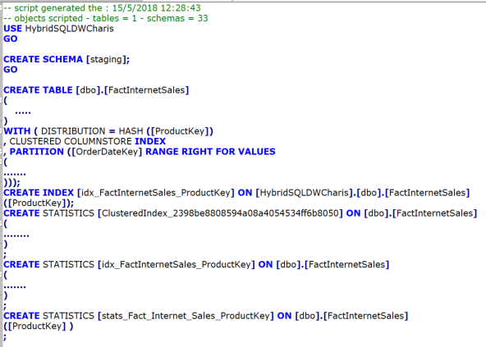
Migration Tools Steps – 2) Clean Scripts
When DWScripter creates the table scripts, additional details are added to the script that are unnecessary for every table, view, or stored procedure created and need to be removed. The Stats and Index creation statements should be removed from the Create table and placed in separate script files to be applied after the data has been loaded. Creating the index/stats and then loading the data into SQLDW will slow down the data loading and the table creation.
Text | Replace with | Description
-- Comments | Delete | No need to have comments in the Create Table statement
Use DBName | Delete | SQLDW does not support USE
GO | Delete | No need for the GO statement
Create Schema | Delete | These do not need to be created in every table.
Create Index | Move to separate script | Create Index statements should be run after the initial load of data has occurred
Create Statistics | Move to separate script | Create Statistics statements should be run after the initial load of data has occurred
; | Delete | Delete all ; as this will cause the deployment script to fail as it is expecting only a single statement to be run.
Notes:
Need to change script to use a config file as the first process will place all scripts in a single directory. If there are multiple schema’s this script will not work for the 3 part names.
Need to figure out why the ‘;’ causes the deployment script to fail.

Slide 60
Migration Tools Steps – 2) Clean Scripts
Create one config file for the Python Program “CleanScripts.py”. This is a CSV file containing the following columns
Run the CleanScripts.py and provide prompted info.
Parameter | Purpose | Value (Sample)
Active | 1 – Run line, 0 – Skip line | 0 or 1
SrcDir | Directory where the APS Scripts resides. This should be the output file directories from Step 1: CreateMPPScripts. Must have “\” on end. | C:\APS2SQLDW\Output\1_CreateMPPScripts\adventure_works\Tables\
OutDir | Output director of this step, where the cleaned scripts will reside. Must have “\” on end. | C:\APS2SQLDW\Output\2_CleanScripts\adventure_works\Tables\
ObjectType | Type of the Scripts | TABLE, VIEW, SP (case insensitive)
Notes:
Scripts are located in our team site at 1)

Slide 61
Migration Tools Steps – 2) Clean Scripts
APS Scripts Generated From Step 1
Create Table Statements (containing Create Index and Create Statistics Statements)
Create View Statements
Create Proc Statements
Cleaned Scripts
Create Table Statements
Separated Create Index Statements
Separated Create Statistics Statements
Create View Statements
Create Proc Statements
CSV Config File for the
Python Program
CleanScripts.py
Prompts:
Configuration file directory (default directory: C:\APS2SQLDW\2_CleanScripts\ )
CSV configuration file name (default file name: clean_scripts.csv)
Clean the scripts stored in source directories and store cleaned scripts in output directories
1 = Run the line
0 = Skip the line
Location of the input files. These are the paths from previous step.
Location of the output files. These are paths for the next step.

Slide 62
Migration Tools Steps – 3) Change Schemas
All Schema changes are enforced by the mapping rules defined in a schema mapping config file. All changes are illustrated below, using the sample schema mapping file below.
Sample Schema Mapping (schemas.csv) :
Schema Change Rules with Sample SP in APS DB adventure_works, with cross DB query to stagedb DB.
Please note that modified code will have consistent coding styles where objects/texts are changed.
# | Text (case insensitive) (with or without “[ ]”) | Replace with | Before (Example) | After (Example)
1 | [APS_DB].[APS_Schema].[Table] | [SQLDW_Schema].[Table] | Create/Delete Table [stagedb].[dbo].[Tmp_Dates] | Create/Delete Table [st_dbo].[Tmp_Dates]
2 | [APS_Schema].[Table] | [SQLDW_Schema].[Table] | CREATE/Delete TABLE [testSchema].[Tmp_Dates] | CREATE/Delete TABLE [adw_testSchema].[Tmp_Dates]
3 | [APS_DB].sys. Or APS_DB.sys. | .sys. | SELECT 1 FROM adventure_works.sys.schemas | SELECT 1 FROM sys.schemas
4 | ‘[APS_DB_Name].[APS_Schema].[Table]’ | ‘[SQLDW_Schema].[Table]' | IF OBJECT_ID('[stagedb].[dbo].[Tmp_Dates]’) IF OBJECT_ID(N'[stagedb].[dbo].[Tmp_Dates]’) | IF OBJECT_ID('[st_dbo].[Tmp_Dates]’) IF OBJECT_ID(N'[st_dbo].[Tmp_Dates]’)
5 | ‘[APS_Schema].[Table]’ | ‘[SQLDW_Schema].[Table]' | IF OBJECT_ID('[testSchema].[Tmp_Dates]’ IF OBJECT_ID(N'[testSchema].[Tmp_Dates]’) | IF OBJECT_ID('[adw_testSchema].[Tmp_Dates If OBJECT_ID(N'[testSchema].[Tmp_Dates]’)
Notes:
Need to change script to use a config file as the first process will place all scripts in a single directory. If there are multiple schema’s this script will not work for the 3 part names.
Need to figure out why the ‘;’ causes the deployment script to fail.

Slide 63
Migration Tools Steps – 3) Change Schemas
1. Create schema mapping configuration file. This is a CSV file containing the following columns:
Parameter | Purpose | Value (Sample)
ApsDbName | Name of one APS Database | adventure_works, stagedb
ApsSchema | The Schema used by the APS Database | dbo, testSchema
SQLDWSchema | The Schema name to be used by SQLDW corresponding to the ApsSchema. | adw_dbo, adw_testScehma
2. Create input and out put directory configuration file. This is a CSV file containing the following columns:
Parameter | Purpose | Value (Sample)
Active | 1 – Run line, 0 – Skip line | 0 or 1
SrcDir | Directory where the input source files that has APS schema names. This is the output files from previous step (Clean Scripts). | C:\APS2SQLDW\Output\2_CleanScripts\adventure_works\Tables
OutDir | Output director of this step, where the scripts with new (SQLDW) scehmas will reside | C:\APS2SQLDW\Output\3_ChangeSchemas\adventure_works\Tables
ObjectType | Type of the Scripts | TATBLE, VIEW, SP (case insensitive)
3. Run the Python Program ChangeSchemas.py with prompted info.
Notes:
Scripts are located in our team site at 1)

Slide 64
Migration Tools Steps – 3) Change Schemas
The schema mapping configuration file needs to be created manually. The default name is schemas.csv.
It is a simple step to create the CSV file by first creating contents in an excel file (.xlsx), and then save it to a CSV file (.csv).
Manually create this Sample schema mapping .xslx file:
File Name: schemas_sample.xlsx
As Input to the Python ChangeSchemas.py.
File Name: schemas_sample.csv
Save As CSV File
“schemas_sample.csv”
Schema CSS in all 3 APS DBs.
It is mapped to different names in SQLDW: CSS_ST, CSS_DW, CSS_DM
Notes:
Need to change script to use a config file as the first process will place all scripts in a single directory. If there are multiple schema’s this script will not work for the 3 part names.
Need to figure out why the ‘;’ causes the deployment script to fail.

Slide 65
Migration Tools Steps – 3) Change Schemas
Cleaned APS Scripts from Previous Step
Create Table Statements
Separated Create Index Statements
Separated Create Statistics Statements
Create View Statements
Create Proc Statements
Notes:
The output Scripts from this step are ready for review, test, and necessary manual changes.
Scripts with SQLDW Schemas
Create Table Statements
Separated Create Index Statements
Separated Create Statistics Statements
Create View Statements
Create Proc Statements
CSV Config Files
Schema Mapping
Input & Output File Paths, and Schema Mapping configuration file.
ChangeSchemas.py
The program performs schema name change and other syntactical changes
to prepare code to run in SQLDW.
Location of the input files. These are the paths from previous step.
Location of the output files. These are paths for the next step
1 = Run the line
0 = Skip the line

Slide 66
Migration Tools Steps – 4) CETAS(APS)/CTAS(SQLDW)
Exporting data from APS to SQLDW can be accomplished using Polybase. This script generates the export and import statements necessary to move the data.
Create a config file in the format below (default name: ScriptCreateExportImportStatementsDriver.cvs)
Run the script ScriptCreateExportImportStatementDriver.ps1. The script does not connect to the APS or SQLDW. The only input for this script is the config.csv file
Parameter | Purpose | Value (Sample)
Active | 1 – Run line, 0 – Skip line | 0 or 1
DatabaseName | Name of the database in APS | AdventureWorks
OutputFolderPath | Name of the path to output the resulte to | C:\Temp\NewDDL\ExportAPS\
FileName | Name of the output file | DimCustomer
SourceSchemaName | Name of the APS/Source Schema | Dbo
SourceObjectName | Name of the source object to work with | DimCustomer
DestSchemaName | Name of the destination schema on SQLDW | Dbo
DestObjectName | Name of the destination object | DimCustomer
DataSource | Name of the data source to use. This must already be created | Export_BlobStorage
FileFormat | Name of the File Format to use when exporting the data. Must already be created | DelimitedNoDateZip
ExportLocation | Path to the export the data to on blobstorage. Each Table should have its own file location | /APS_Export/adw/dbo-DimCustomer/ or /APS_Export/stdb/dbo-DimCustomer
InsertFilePath | Path to write the import statements | C:\Import\SQLDWScripts\
ImportSchema | Name of the new schema on SQLDW | dbo
Notes:
Scripts are located in our team site at 1)

Slide 67
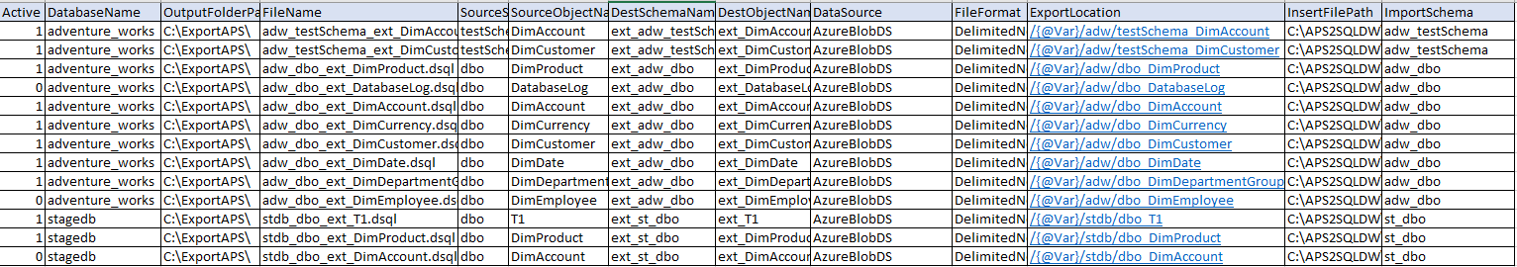
Migration Tools Steps – 4) CETAS(APS)/CTAS(SQLDW)
CETAS Statement.sql
{@Var} is a configurable variable that can be used in any script when using the deployment script in step 6
Example: Location for an external table data
Config.csv
ScriptCreateExportImportStatementsDriver.ps1
Loops through the ScriptCreateExportImportStatementsDriver.cvs file and creates export/import statements
Output File Path
InsertIntoStatement.sql

Slide 68
Migration Tools Steps –5) Create External Tables SQLDW
After the data has been exported from APS, the data now needs to be inserted into SQLDW. Before this can occur, the external table needs to be created on SQLDW. This is completed by using the create table statements and converting the statement into an external table.
Create a config.csv file in the format below.
Run the script ScriptCreateExternalTableDriver_V1.ps1. The script does not connect to the APS or SQLDW. The only input for this script is the config.csv file
Parameter | Purpose | Value (Sample)
Active | 1 – Run line, 0 – Skip line | 0 or 1
OutputFolderPath | Name of the path to output the resulte to | C:\Temp\NewDDL\ExportAPS\
FileName | Name of the output file | DimCustomer
InputFolderPath | Path to the create Table output from step 2 | C:\Temp\NewDDL\
InputFileName | Name of the Create Table script | DimCustomer.dsql
SchemaName | Name of the schema to create the external table in | Dbo
ObjectName | Name of the external table to create | Ext_dimCustomer
DateSource | Name of the data source to use for the external table | Export_BlobStorage
FileFormat | Name of the File Format to use when exporting the data. Must already be created | DelimitedNoDateZip
FileLocation | Path to the export the data to on blobstorage. Each Table should have its own file location | /APS_Export/DimCustomer/
Notes:
Scripts are located in our team site at 1)

Slide 69
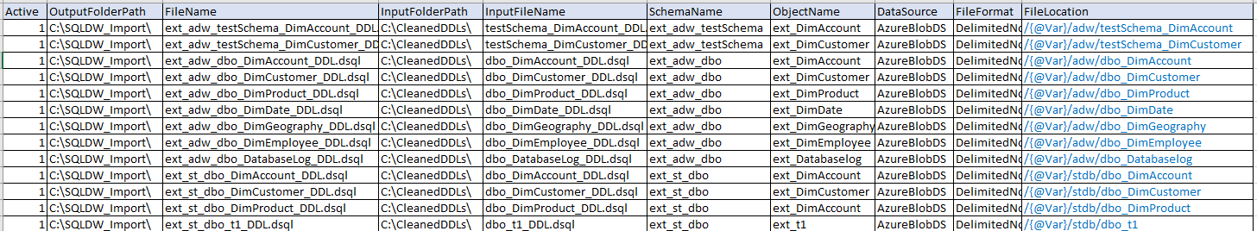
Migration Tools Steps – 5) Create External Tables SQLDW
Config.csv
{@Var} is a configurable variable that can be used in any script when using the deployment script in step 6
Example: Location for an external table data
CreateExternalTable.sql
ScriptCreateExportImportStatementsDriver.ps1
Loops through the config.csv file and creates export/import statements
CreateTable.dsql

Slide 70
Migration Tools Steps – 5) Create External Tables SQLDW
Sample Generated File: ext_adw_dbo_DimAccount_DDL.dsql
CREATE EXTERNAL TABLE [ext_adw_dbo].[ext_DimAccount]
(
[AccountKey] int NOT NULL
,[ParentAccountKey] int NULL
,[AccountCodeAlternateKey] int NULL
,[ParentAccountCodeAlternateKey] int NULL
,[AccountDescription] nvarchar (50)
,[AccountType] nvarchar (50) ,[Operator] nvarchar (50) COLLATE
,[CustomMembers] nvarchar (300) ,[ValueType] nvarchar (50) COLLATE
,[CustomMemberOptions] nvarchar (200)
)
WITH (
LOCATION='/{@Var}/adw/dbo_DimAccount',
DATA_SOURCE = AzureBlobDS,
FILE_FORMAT = DelimitedNoDateZIP)
If the FileLocation has the “{@Var}”, the PowerShell scripts will generate create external table having a configurable location. See example T-SQL Statement generated on the right.
This configurable variable {@Var} can be replaced with a value such as
test – to import data to a location to hold test data
dev – to import data to a locate to hold dev data
prod – to import data to a location to hold prod data.

Slide 71
Migration Tools Steps – 6) Deploy Scripts
The Deployment script is designed to run any .sql file. For the purpose of the migration, it can be used to deploy objects to SQLDW. This tool can drop an existing object before running the .sql file.
Copy the Scripts from Source Repository and Place them on in a local directory.
Any directory structure will work. As a suggestion this path can be used: C:\APS2SQLDW\6_DeployScriptsToSqldw.
Place the two PowerShell scripts in the above directory (RunDSQLScriptDriver.ps1 and RunSQLScriptFile.ps1)
You can choose to put all your CSV configuration files under the above directory, or in a separate directory under it, such as: C:\APS2SQLDW\6_DeployScriptsToSqldw\Config_Files
Select one of the sample configuration files for the purpose of your deployment. All the three sample configuration files use the same format. Sample configuration files provided:
Export APS Data to Azure Blob Storage: ApsCreateExtTablesAndExportData.csv
Create Tables/Views/SPs in Azure SQLDW: SqldwCreateTablesViewsAndSPs.csv
Import APS Data to Azure Blob Storage: SqldwImportData.csv
Notes:
Scripts are located in our team site at 1)

Slide 72
Migration Tools Steps – 6) Deploy Scripts
3. Edit the one of the sample config files to fit the purpose of your deployment, referring to the definition of each column below:
/APS_Migration/DeploymentScripts/ - Powershell Deployment Scripts – Needed for Step 3 Below
/APS_Migration/DDL_DML_Scripts/Schema_Tables/ - Schema and Table .dsql Files – Needed for step 3 Below
Parameter | Purpose | Value (Sample)
Active | 1 – Run line, 0 – Skip line | 0 or 1
ServerName | Name of the SQL Server/SQLDW/APS(PDW) | Sqldwdb.database.windows.net
DatabaseName | Name of the DB to connect to | DBName
FilePath | Path to the Script that needs to be run. Do not put a ‘\’ on the end. | C:\APSScripts\TableScripts
CreateSchema | 1 – Create Schema, 0 – Don’t create Schema | 0 or 1
SchemaAuth | Should a Schema Authorization be needed when creating the schema, enter the name of the Authorization to use. If left empty, no authorization is created. | Login to Create Schema
SchemaName | Schema Name for the object to be created. When a schema is created, the .sqp file is used to create the schema. This is used if the Table/View/SP needs to be dropped. This is the schema name to be used when the script creates the drop statement. | Schema_Name
ObjectType | Type of object to Create. Used to create the drop statement. Valid Values: “”, TABLE, VIEW, SP, (SCHEMA, STAT – Not implemented yet) | TABLE, VIEW, SP, SCHEMA EXT If left blank, not drop statement is created and the .SQL file is just run.
ObjectName | Name of the object that is being created. Used in creating the drop statement and logging. | Name of the object
DropIfExists | 1 – Drop if exist, 0 – Do not drop if exist. Create a Drop statement if the object exists. This could be placed in the .sql file but having it in the config file gives the process more control. Example: Data has been imported into the tables, if the drop was in the .sql, we would need to edit the file to not drop the table. This allows the process to control it with our having to edit the original .sql file. | 0 or 1
Variables | Partial Implementation. Currently supports a single variable. This is used to replace a variable in the .sql file. Example use is for External Tables. This can be used to set the Location, Data_Source or File_Format | @Location=TestLoc {Location}=TestLoc {@Location}=TestLoc Future implementation should separate variables by a ;
Notes:
Scripts are located in our team site at 1)

Slide 73
Migration Tools Steps – 6) Deploy Scripts
4. Run the PowerShell script(RunDSQLScriptsDriver.ps1). This script will prompt for the following information
“Enter the name of the Script Config csv File.” – This will be the location\name of your configuration file.
C:\APS2SQLDW\6_DeployScriptsToSqldw\Config_Files: SqldwCreateTablesViewsAndSPs.csv or ApsCreateExtTablesAndExportData.csv or SqldwImportData.csv
“How do you want to connect to SQL(ADPass, ADInt, WinInt, SQLAuth)?”
ADPass – This should be used for SQL Authentication with Password (Azure)
ADINT – Azure AD Authentication
SQLAUTH – SQL Server Authentication with username and password.
“Blank” – AD integrated Authentication
“Enter the User Name to Connect to the SQL Server.” – User name with permission to create objects
“Enter the Password for the User” – Enter the Password for the user – reads password as a secure string
“Enter the name of the Output File Directory.” – Enter the location where the output log will be written
“Enter the name of the status file.” – Enter the name of the Status File
5. Review the Status log for Success Failures.
Review the status log file. The file name and location are the prompted values of the PowerShell program in step 3). The default location is the location of the PowerShell scripts with the file name status.csv.
Should a failure occur, the Status log will set the Active flag to 0 for all successful objects created The Failures will remain Active = 1. This will allow the status log to be used as the Script Config file and only the failed objects will be run
Notes:
Scripts are located in our team site at 1)

Slide 74
Migration Tools Steps – 6) Deploy Scripts
6. The Output file is a CSV that records the status and duration of the statement run. This file can be used as the input for a second run. In a second run only the failed lines will be run.
Parameter | Purpose | Value (Sample)
Active | 1 – Run line, 0 – Skip line Sets the 1 to 0 if the .sql ran successfully. IF set to 0, output = 0 | 0 or 1
ServerName | Name of the SQL Server/SQLDW/APS(PDW) | Sqldwdb.database.windows.net
DatabaseName | Name of the DB to connect to | DBName
FilePath | Path to the Script that needs to be run. Do not put a ‘\’ on the end. | C:\APSScripts\TableScripts
CreateSchema | 1 – Create Schema, 0 – Don’t create Schema | 0 or 1
SchemaAuth | Should a Schema Authorization be needed when creating the schema, enter the name of the Authorization to use. If left empty, no authorization is created. | Login to Create Schema
SchemaName | Schema Name for the object to be created. When a schema is created, the .sql file is used to create the schema. This is used if the Table/View/SP needs to be dropped. This is the schema name to be used when the script creates the drop statement. | Schema_Name
ObjectType | Type of object to Create. Used to create the drop statement. Valid Values: “”, TABLE, VIEW, SP, (SCHEMA, STAT – Not implemented yet), EXT (External Table) | TABLE, VIEW, SP, EXT, SCHEMA If left blank, not drop statement is created and the .SQL file is just run.
ObjectName | Name of the object that is being created. Used in creating the drop statement and logging. | Name of the object
DropIfExists | 1 – Drop if exist, 0 – Do not drop if exist. Create a Drop statement if the object exists. This could be placed in the .sql file but having it in the config file gives the process more control. Example: Data has been imported into the tables, if the drop was in the .sql, we would need to edit the file to not drop the table. This allows the process to control it with our having to edit the original .sql file. | 0 or 1
Variables | Partial Implementation. Currently supports a single variable. This is used to replace a variable in the .sql file. Example use is for External Tables. This can be used to set the Location, Data_Source or File_Format | @Location=TestLoc {Location}=TestLoc {@Location}=TestLoc Future implementation should separate variables by a ;
Status | if Active is set to 0 – “Status = 0, Process was not run.” “Success” “Error message from process”
Duration | How long it took to run the .sql statement in Seconds | 0-N seconds
Notes:
Scripts are located in our team site at 1)

Slide 75
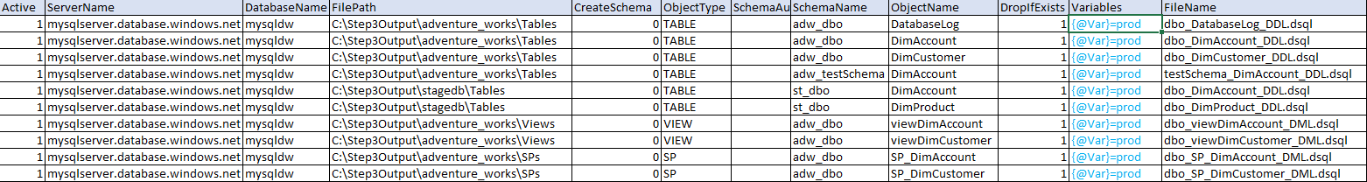
Migration Tools Steps – 6) Deploy Scripts
Create Schema A.sql
Create Table B.sql
Create Table C.sql
Status Log
Sets Active Flag = 0 if run successfully
Sets Active Flag = 1 on Failure
Records Status/Error Msg
CVS Script Config File
RunDSQLScriptsDriver.ps1
Prompts: Login Info, Config File Location, log file location.
Reads the Config file
Loops through Config file and executes .dsql script where Active = 1
RunSQLScriptFileV2.ps1
Executes the Drop if Exist if necessary
Executes the .dsql Script
Schema\Table Created
{@Var} is now set to a desirable value, such as “dev”, “prod”, “test”
Sample config file for creating tables/views/SPs in SQLDW. File Name: SqldwCreateTablesViewsAndSPs.csv

Slide 76
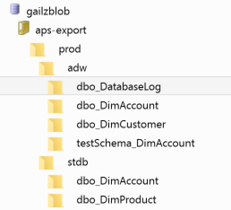
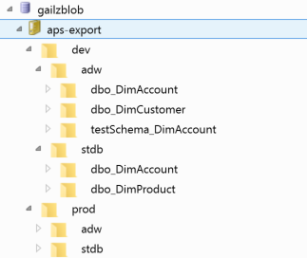
Migration Tools Steps – 6) Deploy Scripts
Sample config file for creating external tables in APS and Export APS Data. File Name: ApsCreateExtTablesAndExportData.csv
After previous step,
We could, if needed, set {@Var}=dev
Then we perform the APS export again, this time, exported data to this location:
/aps-export/dev/
The result is illustrated on the right.
Initially, we set {@Var}=prod
We exported production APS DB.
/aps-export/prod/
The result is illustrated on the right.

Slide 77
DDL Schema Change (done by Python Program)
The schema mapping must be performed for all “Create Table” statements. ‘Heap’ Table must be specified explicitly in SQLDW. Otherwise, SQLDW creates Clustered ColumnStore Index (CCI) for the table.
Example: APS DDL - Create Table
Example: SQLDW DDL - Create Table (Same table)
-- CS_STAGE DB
CREATE TABLE [CSS].[etlLoadConfig]
(
[procedureName]nvarchar(900)
COLLATELatin1_General_100_CI_AS_KS_WSNULL
-- More lines omitted
,[targetTableDeleteKey]nvarchar(900)
COLLATELatin1_General_100_CI_AS_KS_WSNULL
)
WITH ( DISTRIBUTION = HASH ([procedureName]))
-- SQLDW
CREATE TABLE [CSS_ST].[etlLoadConfig]
(
…..
)
WITH ( DISTRIBUTION = HASH ([procedureName])
,HEAP)

Slide 78
DDL Stats and Index Change (done by Python Program)
To speed up the data migration, we will remove “Create Index” and “Create Statistics” statements, put them in a separate file, update the schemas, save the file for later use. After the data migration, these Indexes and Statistics will be created in SQLDW environment.
Example: APS DDL -
CREATE INDEX & CREATE STATISTICS
Example: SQLDW DDL -
CREATE INDEX & CREATE STATISTICS
-- CS_DATAWAREHOUSE DB
CREATE INDEX [idx_X_ProductKey]
ON [CSS].[Billing_Table]
([ProductKey])
CREATE STATISTICS [idx_Y_ProdNDateKey]
ON [CSS].[Billing_Table]
([ProductKey]
,[OrderDateKey] )
-- SQLDW
CREATE INDEX [idx_X_ProductKey]
ON [CSS_DW].[Billing_Table]
([ProductKey])
CREATE STATISTICS [idx_Y_ProdNDateKey]
ON [CSS_DW].[Billing_Table]
([ProductKey]
,[OrderDateKey] )

Slide 79
View Schema Change (done by Python Program)
Schema mapping in Views. Same DDL schema mapping rules apply to Views.
This is performed manually. Simple views can be changed by scripting tool.
Example View (Before and After):
-- Example View in CS_DATAMART DB before change (APS)
CREATE VIEW [CSS].[VIEW_Customer_Attributes_Enriched] AS SELECT *
FROM
CSS.Customer_Attributes_Enriched_History
WHERE
sys_scd_IsCurrent = 1;
-- Example View in CS_DATAMART DB after change (SQLDW)
CREATE VIEW [CSS_DM].[VIEW_Customer_Attributes_Enriched] AS SELECT *
FROM
CSS_DM.Customer_Attributes_Enriched_History
WHERE
sys_scd_IsCurrent = 1;

Slide 80
Stored Procedure Schema Change (done by Python Program)
The new schemas of the Target SQLDW Stored Procedures (SP) will be placed in places of APS schemas, with the mappings defined in the schema mapping configuration file
( ‘schema.cs’) explained earlier.
-- Example SP in CCIBI_STAGE DB after change.
CREATE PROC [CS_STAGE].[SP_Example] AS
CREATE PROC [CSS_ST].[SP_Example] AS
BEGIN
CREATE TABLE DimCustomers
CREATE TABLE [CSS_ST].DimCustomers
WITH (DISTRIBUTION = Hash ([Reference_Doc_Number]), HEAP)
AS
SELECT
……
FROM CS_DATAMART.Customer_Attributes_Current AS CA
FROM [CSS_DM].Customer_Attributes_Current AS CA
END

Slide 81
Migration Changes - Stored Procedure (SP) Sample
Same DDL schema mapping rules apply to SP.
The schema mapping and changes must be performed for all “Create Proc” and “Create Table” Statements. The same changes must be performed for all other tables that are referenced by the SP.
Examine all “Create Table” statements. Add “, HEAP” explicitly if the CREATE TABLE does not explicitly state the table index type.
-- Example SP in CS_STAGE DB after change.
CREATE PROC [CSS].[SP_Example] AS
CREATE PROC [CSS_ST].[SP_Example] AS
BEGIN
CREATE TABLE #PHY_TMP_Customers
WITH (DISTRIBUTION = Replicate, Location = User_DB)
WITH (DISTRIBUTION = Round_Robin, HEAP, Location = User_DB)
AS
SELECT
……
FROM CS_DATAMART.CSS.Customer_Attributes_Current AS CA
FROM CSS_DM.Customer_Attributes_Current AS CA
END

